Slide 1
INTRODUCTION TO SQL
SQL stands for Structured Query Language.
It is used for storing and managing data in relational database management system (RDMS).
It is a standard language for Relational Database System.
It enables a user to create, read, update and delete relational databases and tables.
There are mainly 4 ways to manipulate data stored in an RDBMS.
i) DDL: Data Definition Language
ii) DML: Data Manipulation Language
iii) TCL: Transaction Control Language
iv) DCL: Data Control Language
v) DQL: Data Query Language

Slide 2
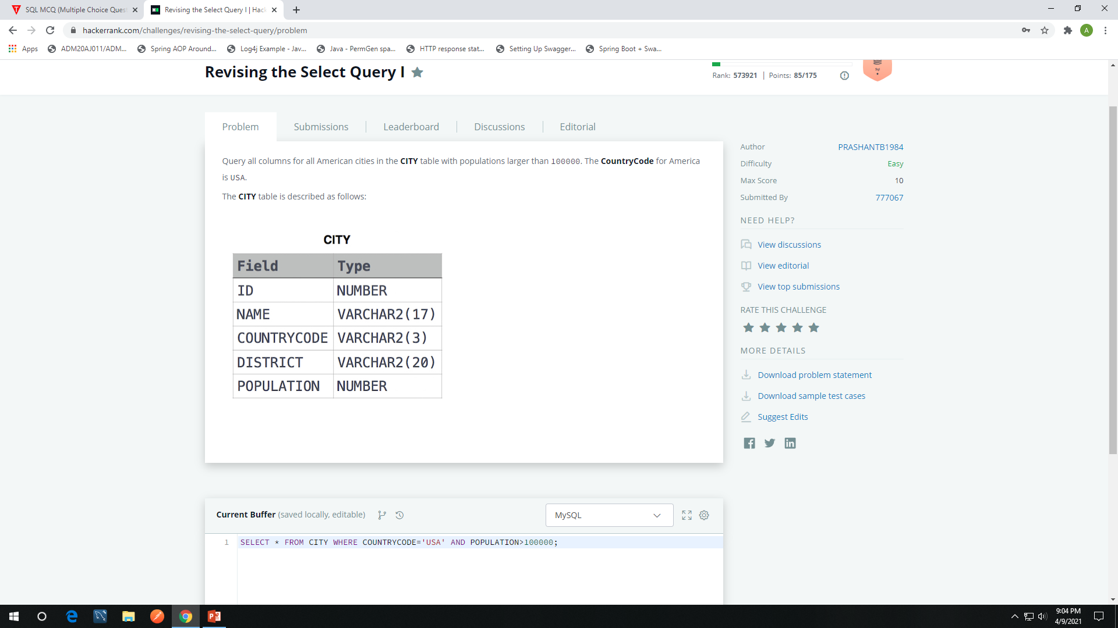

Slide 3
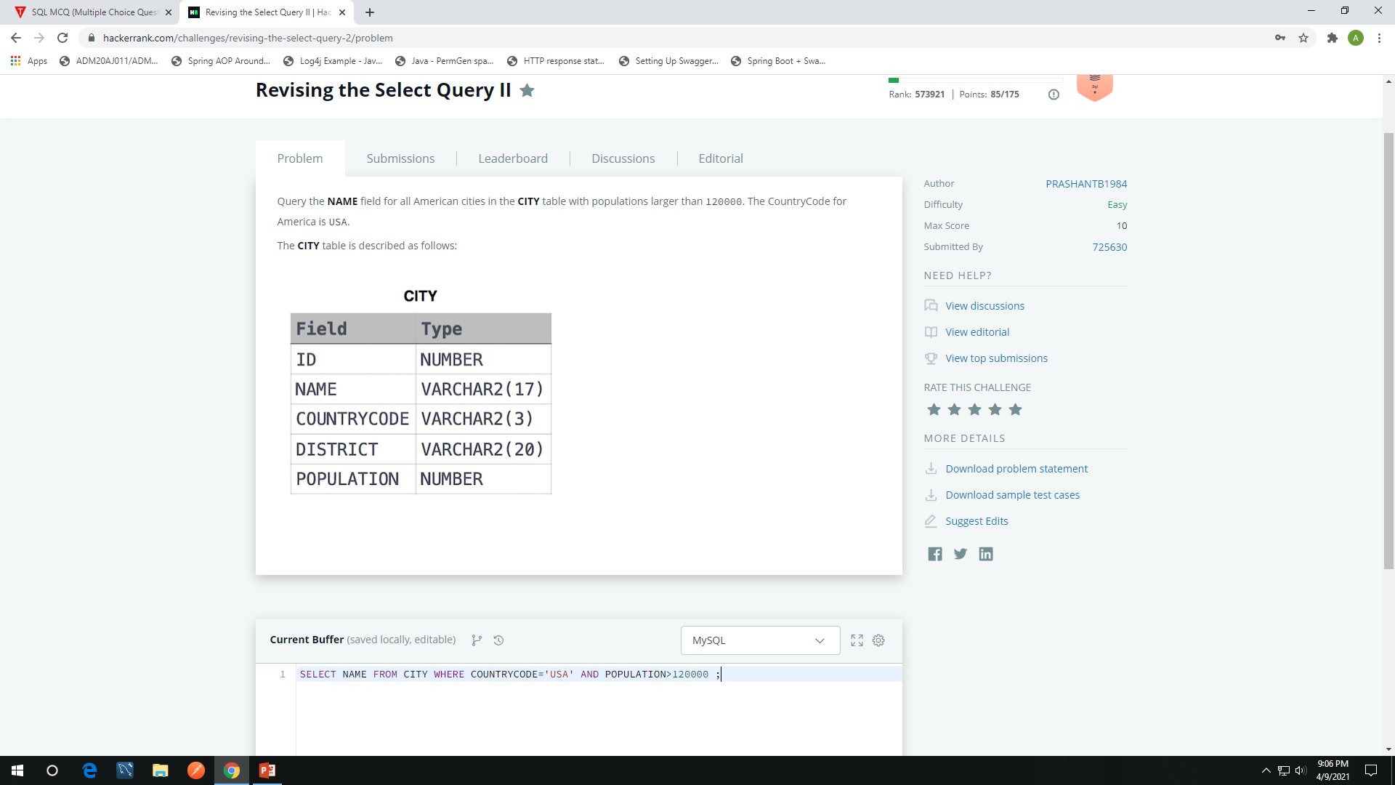

Slide 4
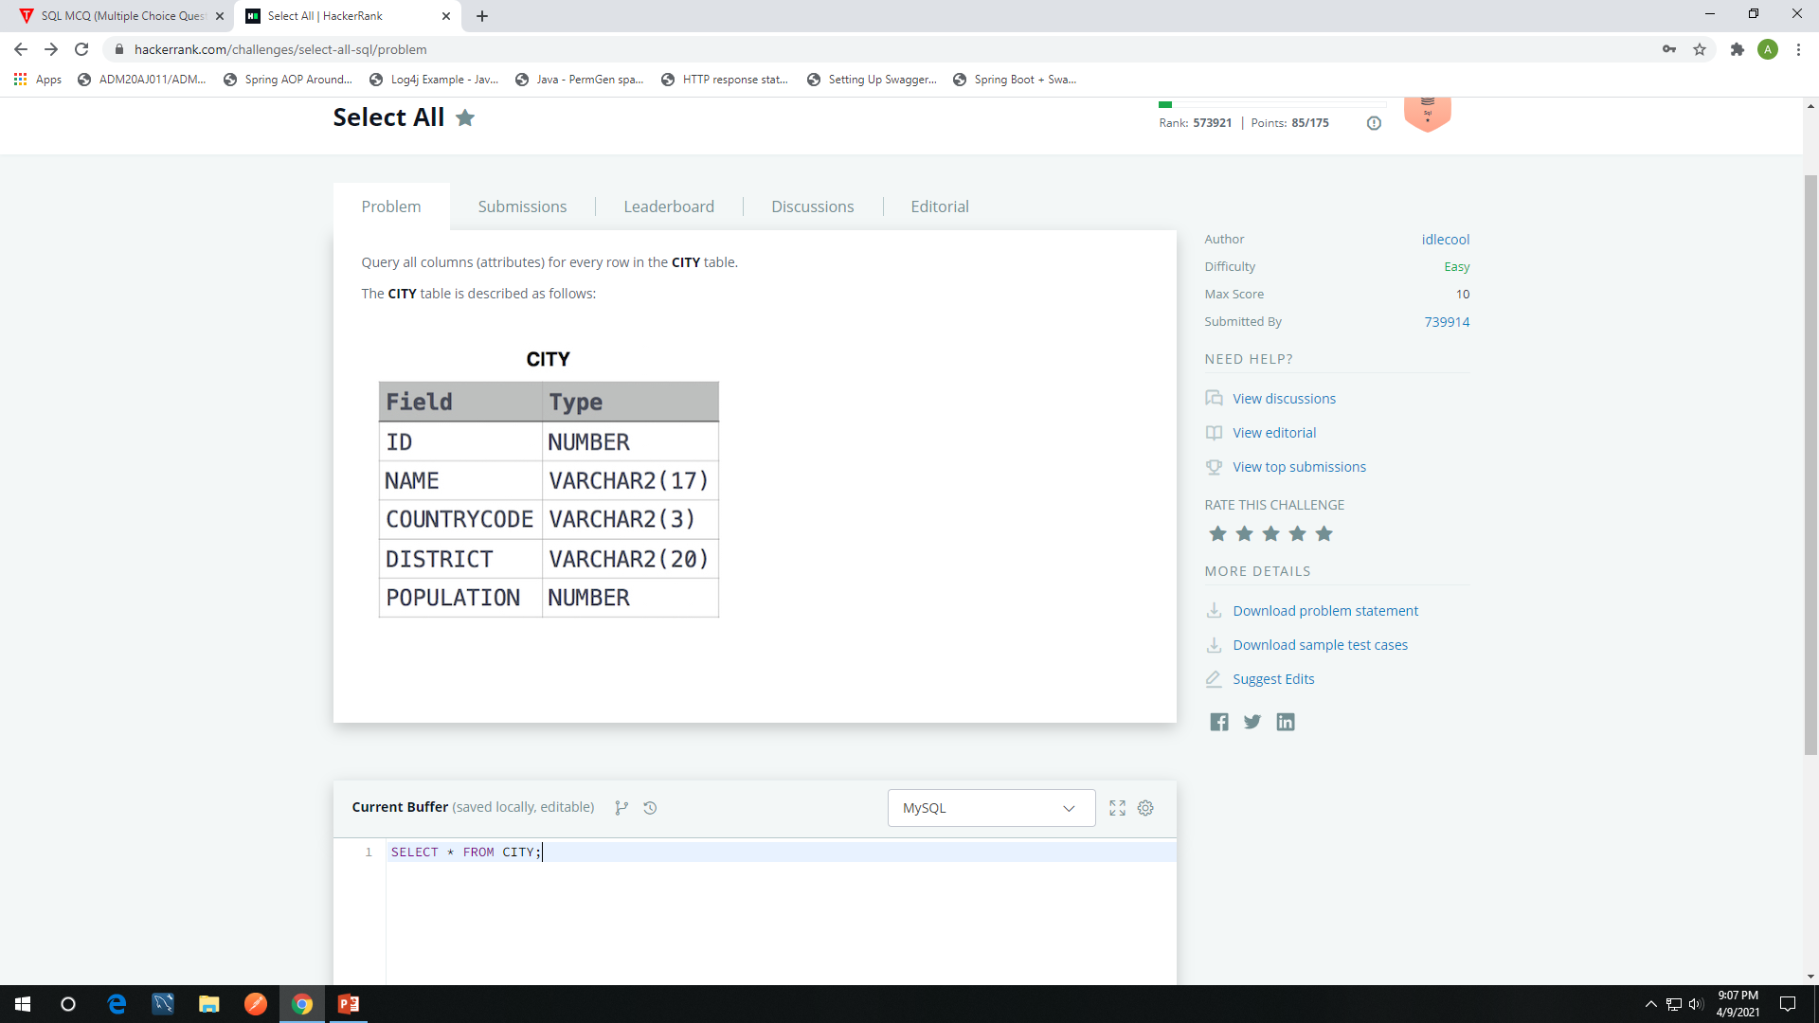

Slide 5


Slide 6
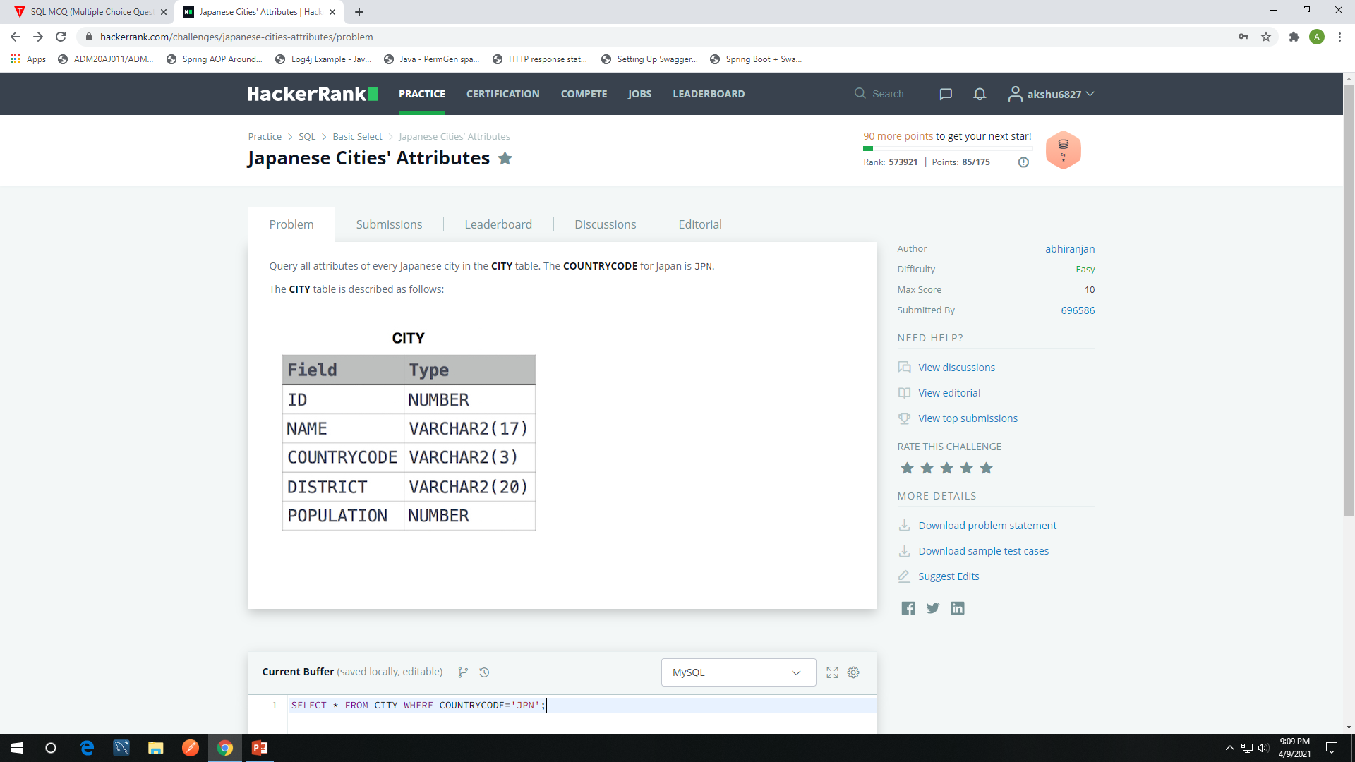

Slide 7
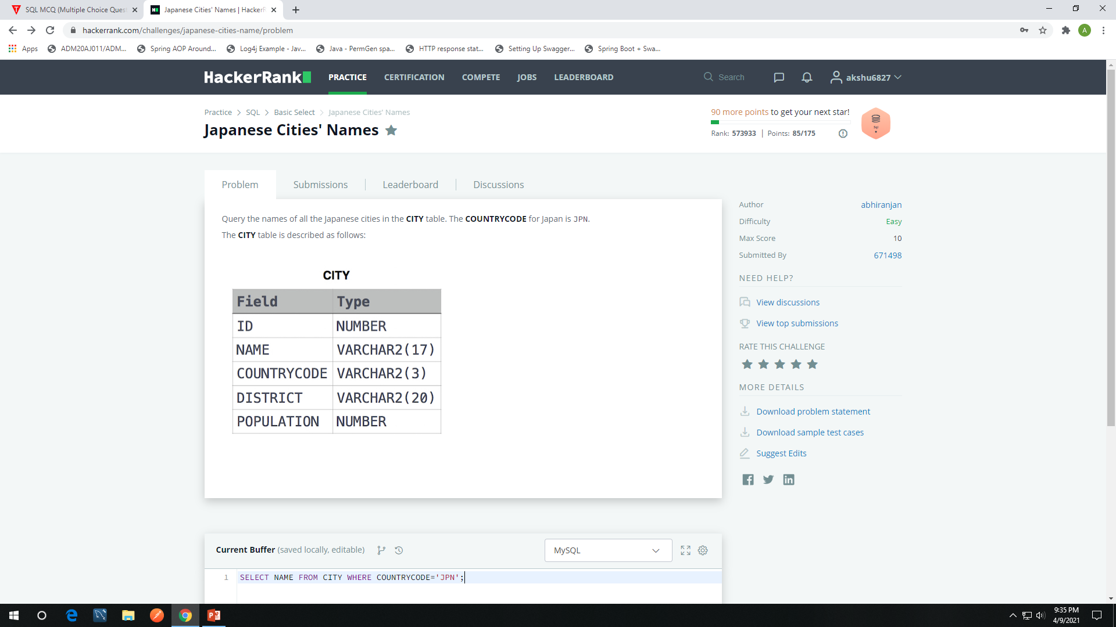

Slide 8
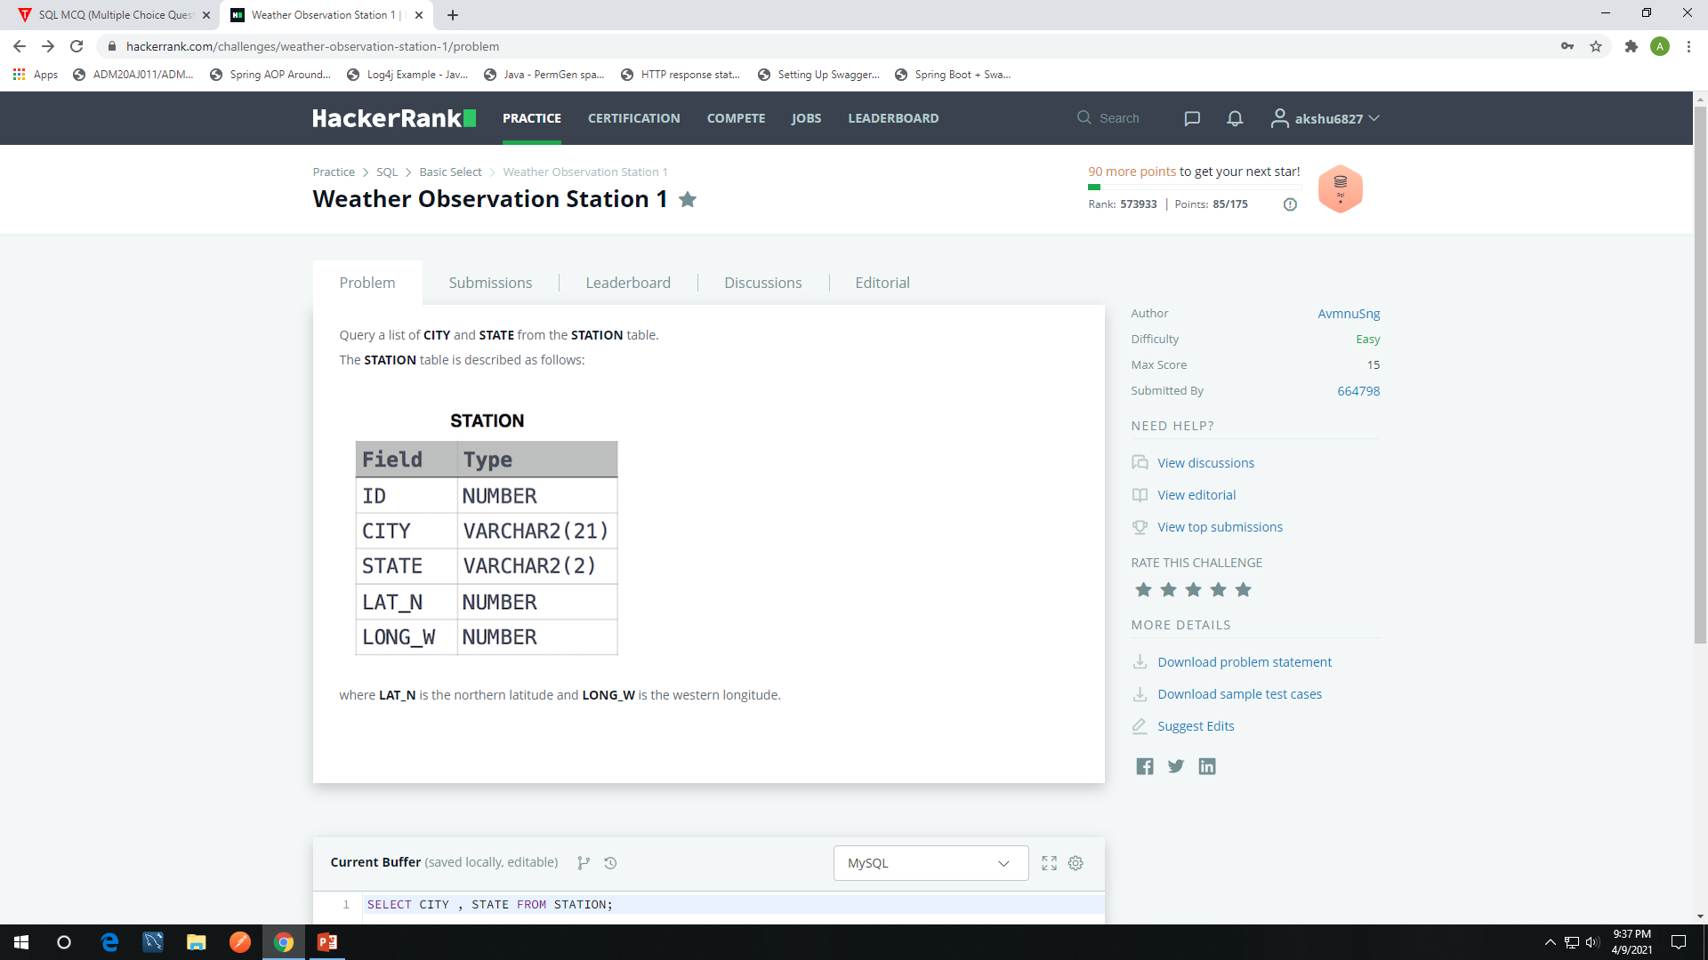

Slide 9
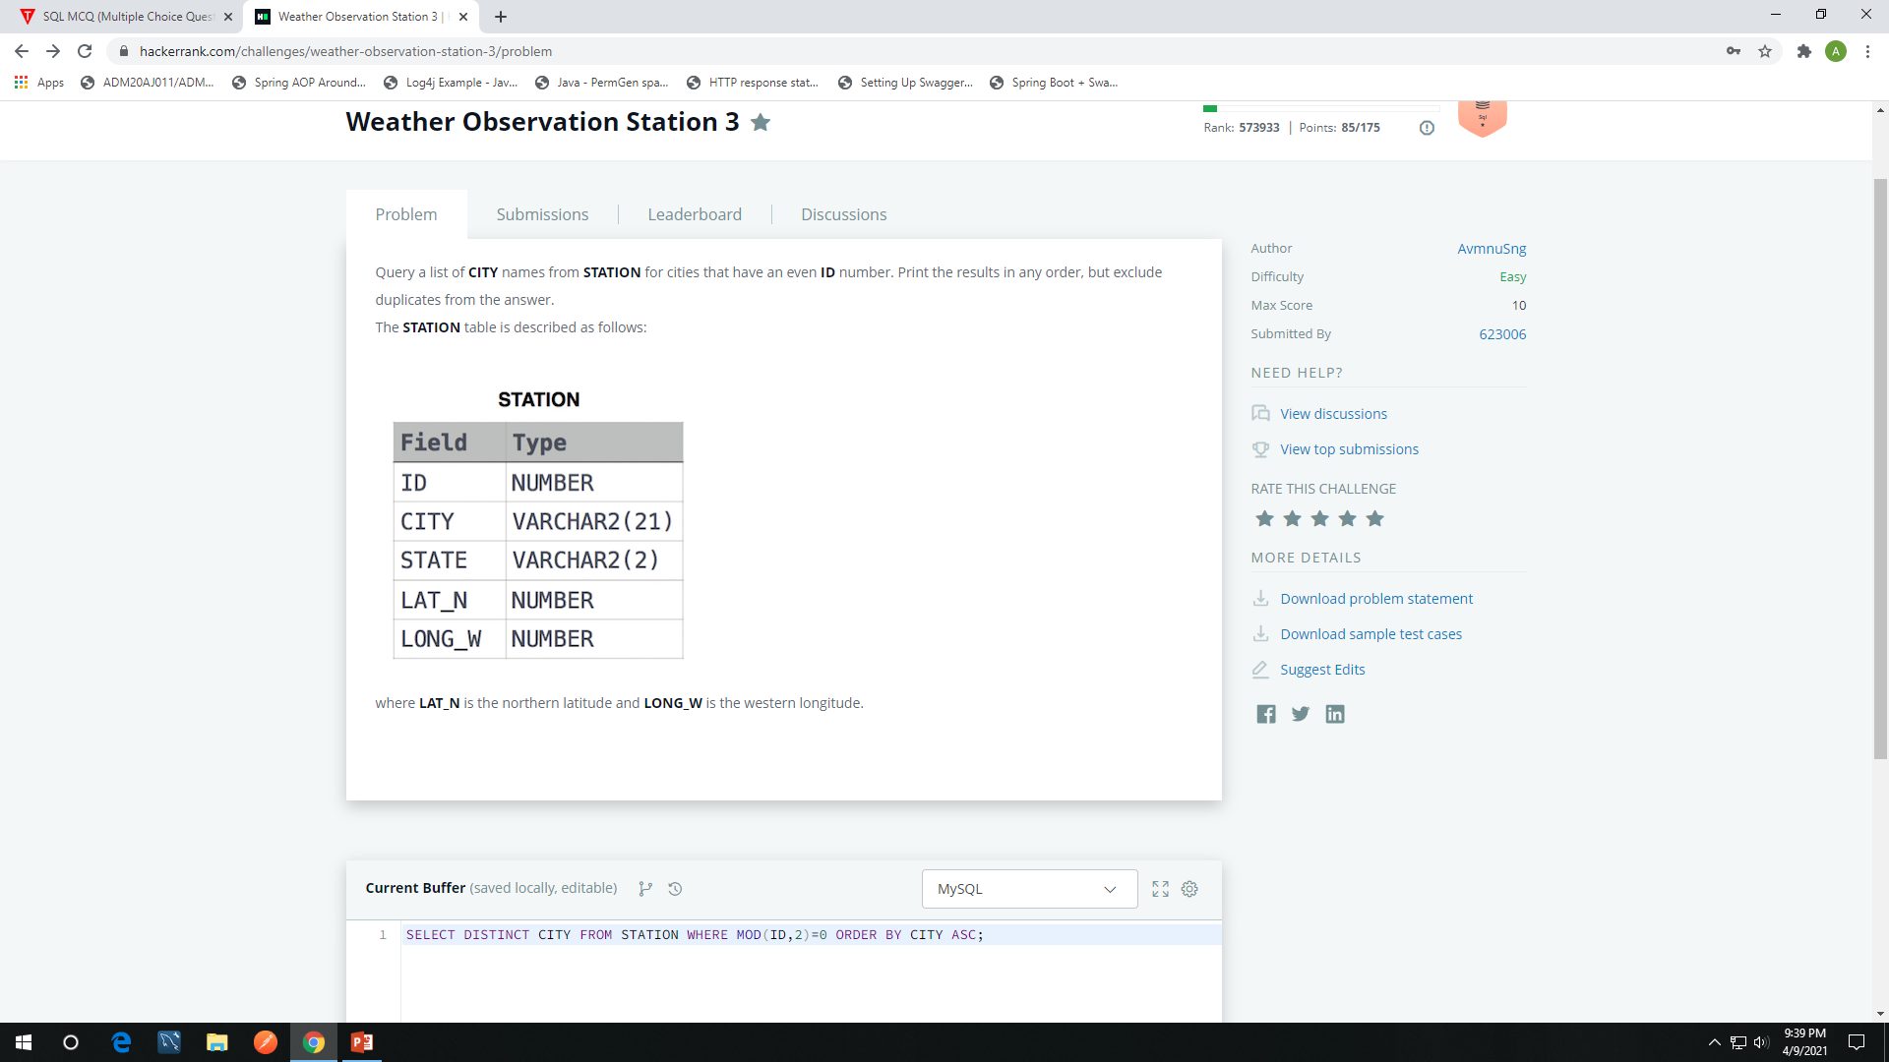

Slide 10
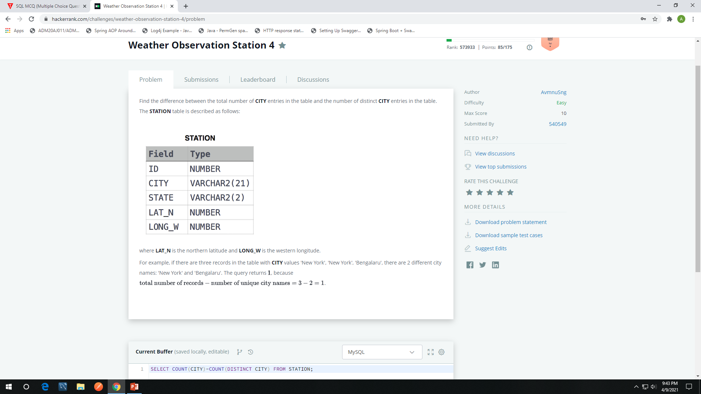

Slide 11
MCQ’s On SQL Basics :
1) Which of the following is not a valid SQL type?
Float
Numeric
Decimal
Character
2) Which of the following is not a DDL command?
TRUNCATE
ALTER
CREATE
UPDATE
3) Which of the following are TCL commands?
COMMIT and ROLLBACK
UPDATE and TRUNCATE
SELECT and INSERT
GRANT and REVOKE

Slide 12
4) Which statement is used to delete all rows in a table without having the action logged?
DELETE
REMOVE
DROP
TRUNCATE
5) SQL Views are also known as
Simple tables
Virtual Tables
Complex Tables
Actual Tables
6) Which of the following is not a valid aggregate function?
COUNT
COMPUTE
SUM
MAX

Slide 13
7) In which of the following cases a DML statement is not executed?
When existing rows are modified.
When a table is deleted.
When some rows are deleted.
All of the above
8) Which statement is true regarding procedures?
They include procedural and SQL statements.
They work similarly to the functions.
It does not need unique names.
It cannot be created with SQL statements.
9) Which of the following is true about the SQL AS clause?
The AS clause in SQL is used to change the column name in the output or assign a name to a derived column.
The SQL AS clause can only be used with the JOIN clause.
The AS clause in SQL is used to defines a search condition.
All of the mentioned

Slide 14
10) How can you change "Thomas" into "Michel" in the "LastName" column in the Users table?
UPDATE User SET LastName = 'Thomas' INTO LastName = 'Michel‘
MODIFY Users SET LastName = 'Michel' WHERE LastName = 'Thomas‘
MODIFY Users SET LastName = 'Thomas' INTO LastName = 'Michel‘
UPDATE Users SET LastName = 'Michel' WHERE LastName = 'Thomas‘
11) To specify the number of records to return, which keyword is used
ROW
TOP
START
LIMIT
12) To search for a specified pattern in a column
SQL MATCH
SQL LIKE
SQL PATTERN
SQL SEARCH

